Slide 1

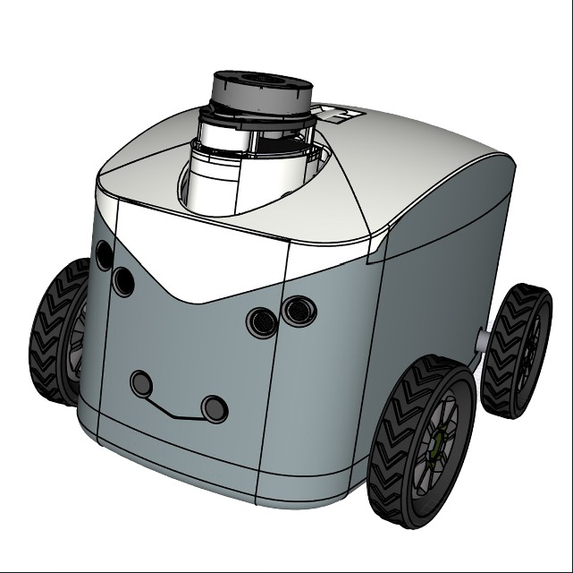
SLAM for an Autonomous Package Delivery Robot
Project Work
Miguel Rodriguez

Slide 2
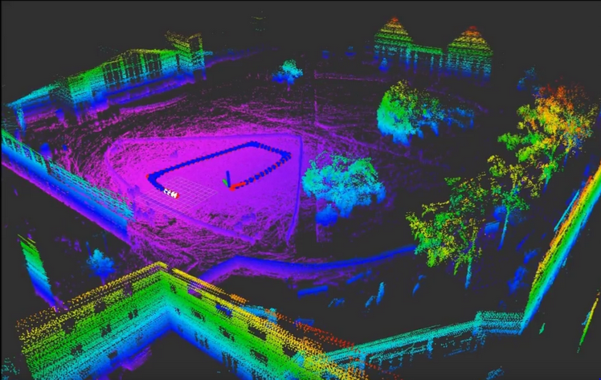
Motivation
To build a map and localize itself in an unknown environment.
One of the most important requirements for autonomous robots
Already several implementations
Not yet fully perceptual maps

Slide 3
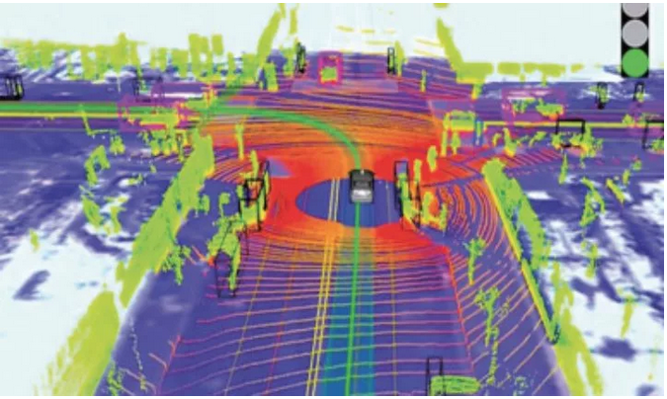
Goals
To build a prototype of an autonomous delivery robot
Generate a Simultaneous Mapping and Location (SLAM) for the robot

Slide 4
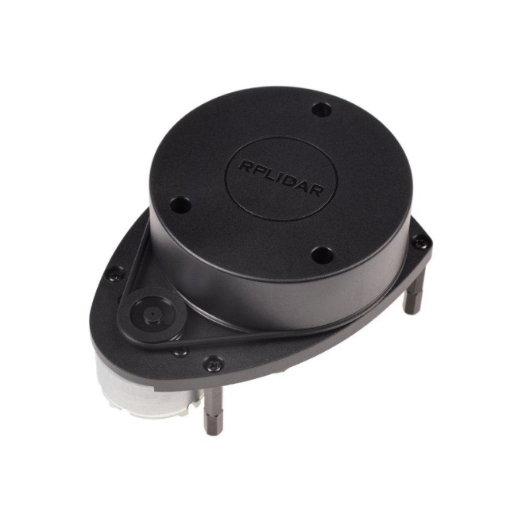

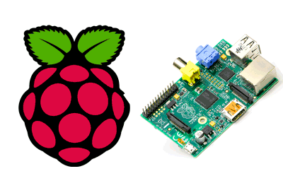

Fundamentals
LiDAR

Slide 5
Related work
Visual SLAM
Camera based SLAM
NAV2
SLAM process based on LiDAR information and odometry
HECTOR SLAM
No odometry required
Map generated comparing data acquired from continuous measurements
First measurement is fundamental for correct calculations

Slide 6
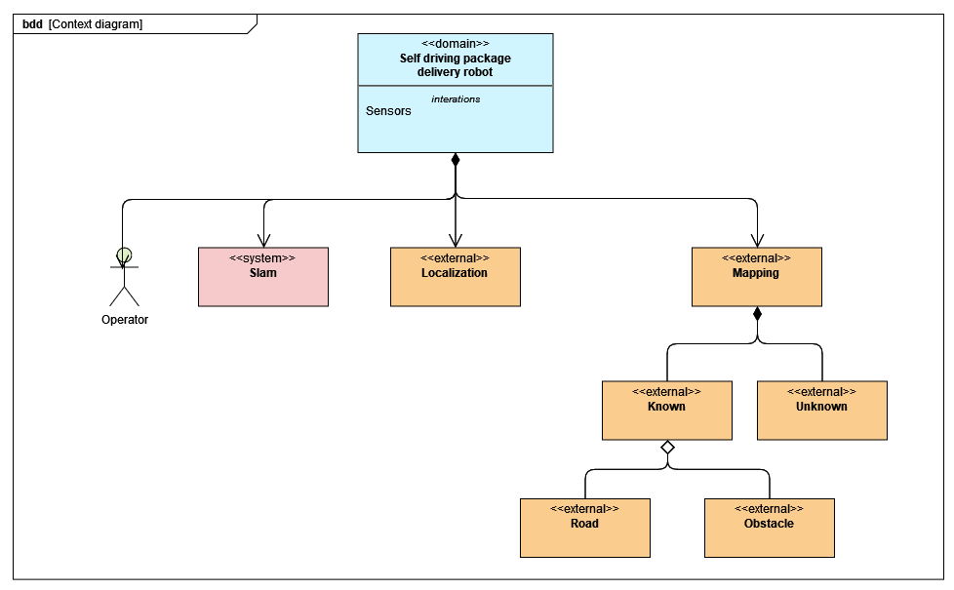
Analysis - Context

Slide 7
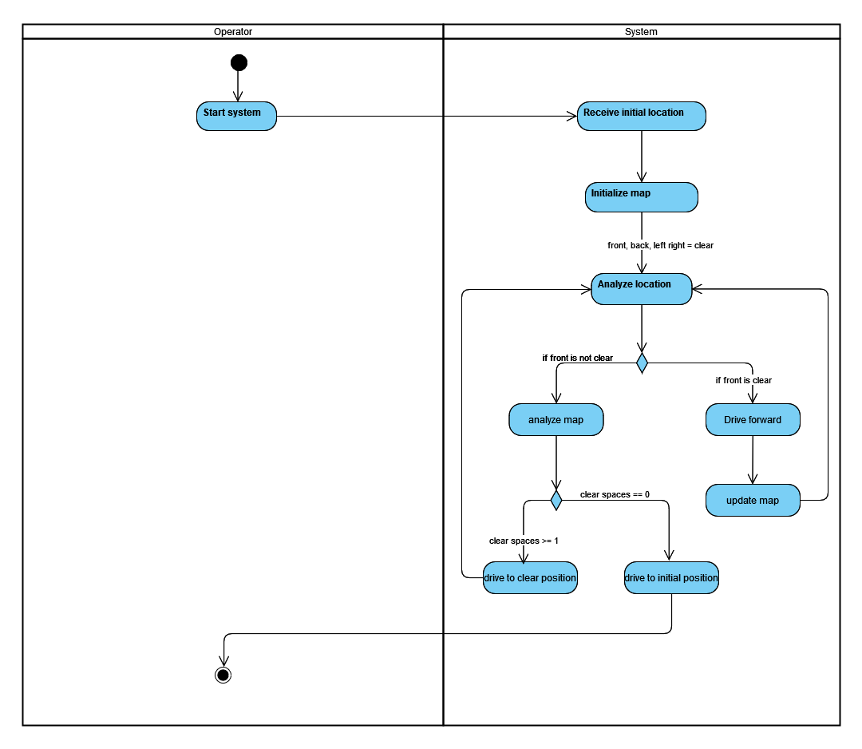
Analysis – Main activity

Slide 8
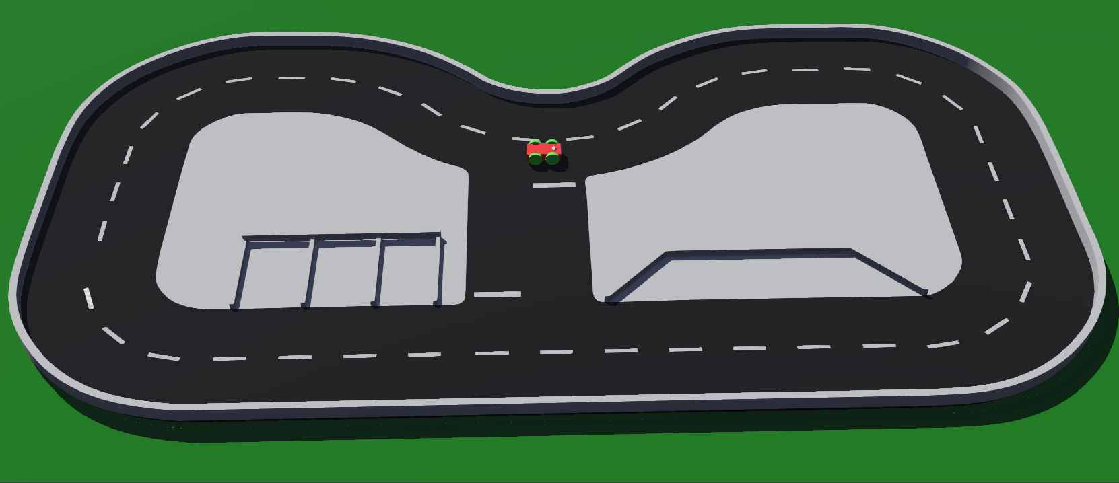
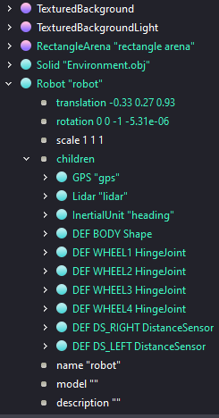
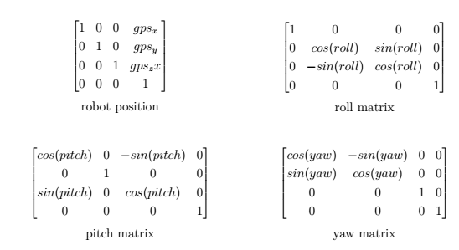
Design and implementation
Simulation in Webots

Slide 9
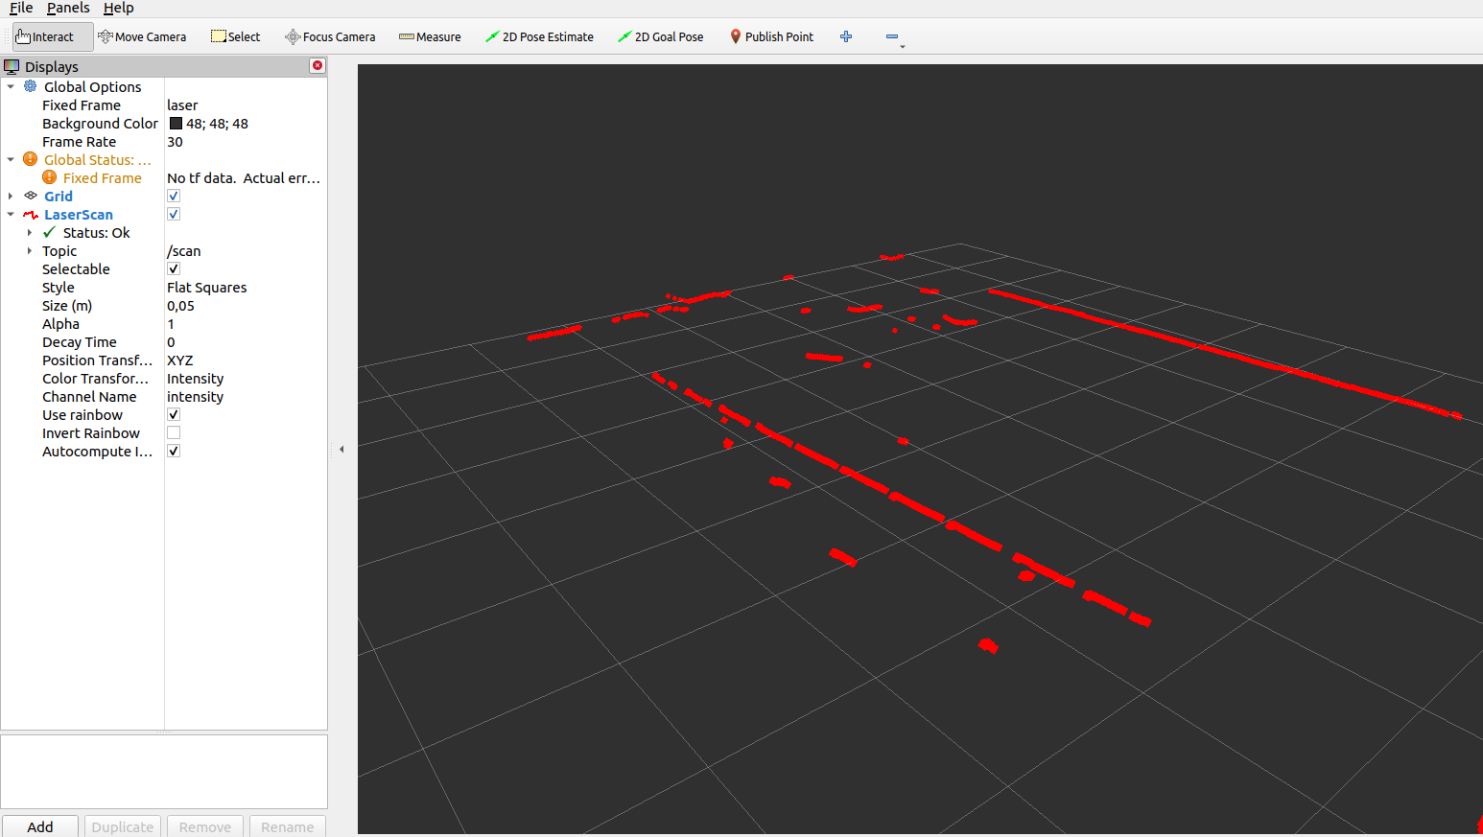
Physical project in ROS

Slide 10
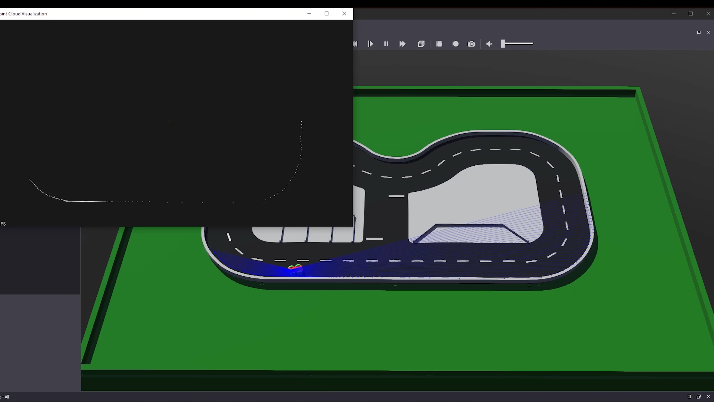
Webots point cloud map generation

Slide 11
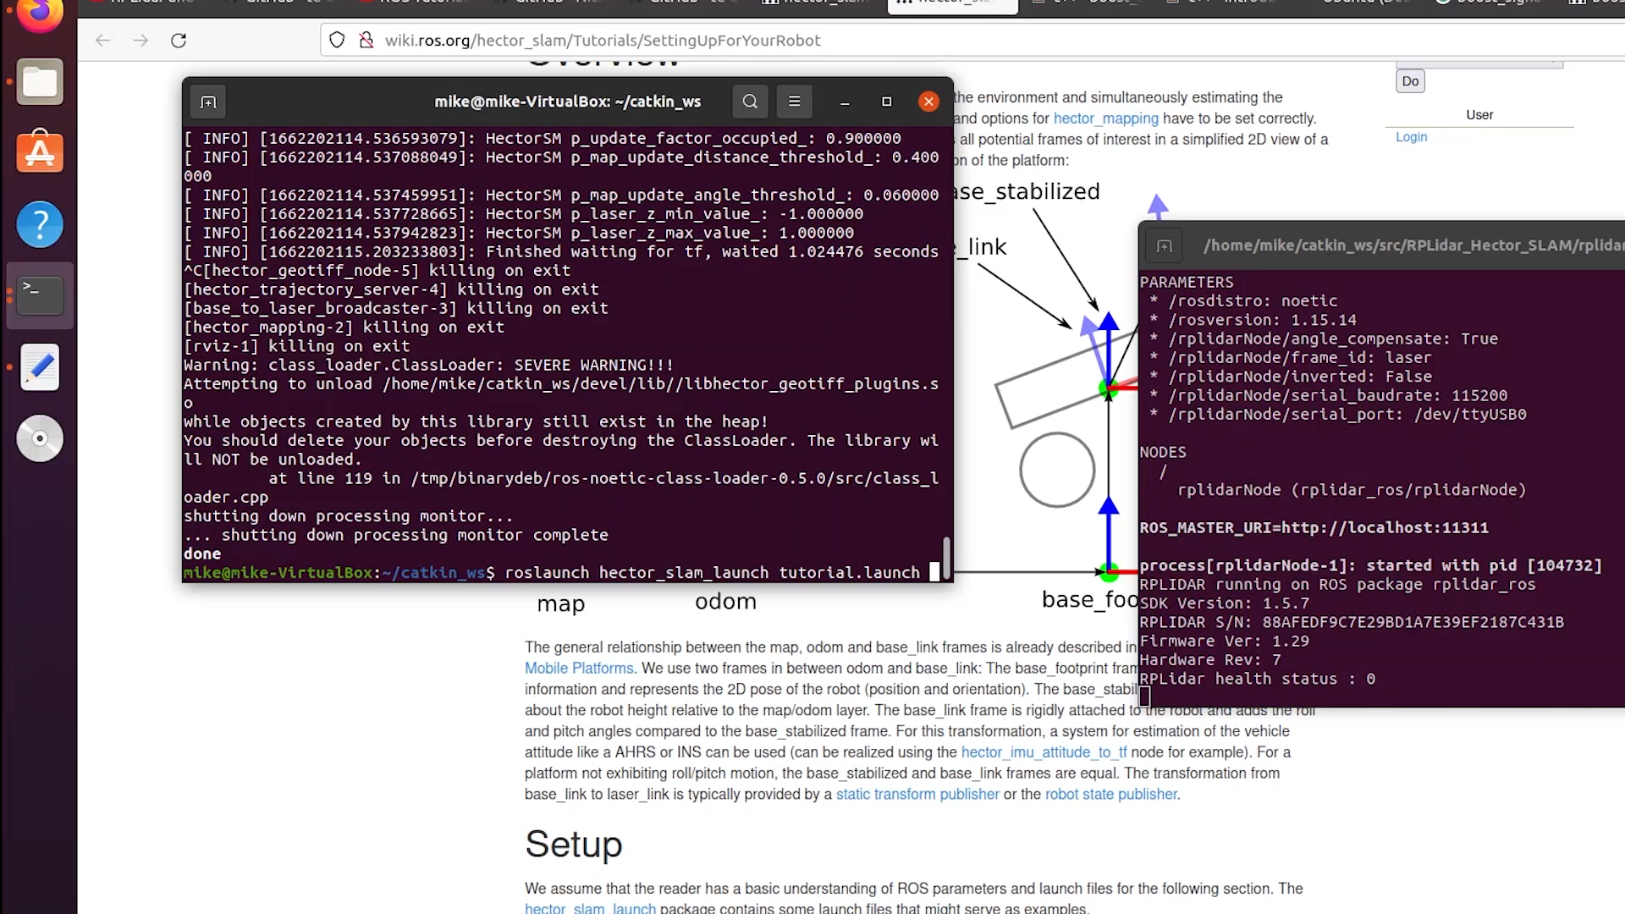
HECTOR SLAM

Slide 12
Summary and Outlook
Showed how to implement SLAM algorithms with minimal elements
Showed how to implement both in simulation and physical
Look forward to integrate the 5 scenarios
Implement NAV2 using odometry
Implement a visual slam algorithm.

